Slide 1
HACKFRONT INDIA 2026
NIRANTAR
Innovation Track | Open Innovation (Neo4j & Sarvam AI)
Problem Statement Title | AI & Neo4j GraphRAG Early Warning and Cascade Monitoring System - NIRANTAR
Theme | Disaster Resilience & Deep Tech
League Phase | Diagnose · Design · Deploy
Team Name | ICONIX

Slide 2
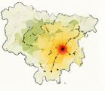
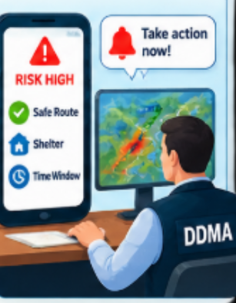

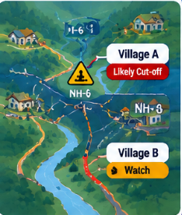
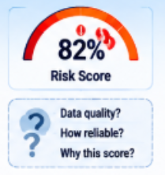
IDEA TITLE
ICONIX
ICONIX
NIRANTAR
Predict the risk. Protect the route. Prioritize the people.
PROBLEM STATEMENT
PROPOSED SOLUTION
To Build an AI and Neo4j GraphRAG early warning system using rainfall, soil moisture, and DEM terrain data and monitor vulnerable roads, substations, hospitals, and villages for timely Sarvam voice alerts and evacuations.
Fuse rainfall, soil moisture, and DEM physics with a 4-layer Neo4j multiplex graph to model hazard risk to predict 3-hop infrastructure cascades, road isolation, and hospital backup windows and guide decisions with confidence aware risk, Sarvam voice alerts, and A* routing.
CORE PROBLEMS
UNIQUENESS / NOVELTY
A road can fail before evacuation is complete.
Regional risk needs slope-level action.
Risk scores need confidence and data-quality context.
Remote areas need warnings that still work offline.
Misses 3-hop power, water, and road cascades.
Neo4j 3-hop cascade & road-isolation graph.
Dynamic evacuation & ICU backup window.
DEM physics gate + zero-hallucination AI.
Sarvam voice cards + A* shelter routing.
4-Agent GraphRAG Copilot + UAV/USV loop.

Slide 3






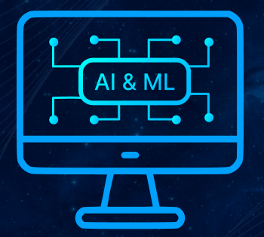













TECHNICAL APPROACH
ICONIX
System Architecture
TECH STACK
1 · DATA INGESTION
2 · AI RISK ENGINE
Technology Stack
Rainfall IMD · IMERG
Risk Engine XGBoost
+ rainfall
thresholds
3.HUMAN VALIDATION - DDMA officer
Data Sources
IMD • GPM-IMERG • Sentinel-1 • SMAP • DEM
Satellite Sentinel · SMAP · DEM
Neo4j 3-hop cascade
Python • XGBoost • Llama 3.1 • GraphRAG Agents
Sarvam STT & Vision OCR
Impact Runout · Road isolation ·
P1/P2/P3
AI / ML
decide
GEO-SPATIAL
Neo4j GDS • DEM Gate • A* Road Routing
field reports
6.CITIZEN RESPONSE
4.GOVERNMENT DECISION
BACKEND
FastAPI • Neo4j AuraDB •
PostGIS • REST API
Escalation alert
Green→Yellow→Orange→Red
5 · DISSEMINATION
SACHET / CAP 1.2
Risk map + P1/P2/P3 tiers
What-if simulator
Village action card in local language + voice
React • PWA • Offline Maps
Safe route & shelter
offline maps
Cell broadcast + SMS
FRONTEND
4-Agent GraphRAG trace
Audit trail Created→Approved→Ack
Works offline BLE / Wi-Fi Direct mesh
Sarvam Bulbul TTS
COMMUNICATION
Acknowledge & report back to DDMA
Peers GSI · NESAC · IMD · 112
Sarvam STT/TTS • CAP • UAV/USV • BLE
ack / audit

Slide 4
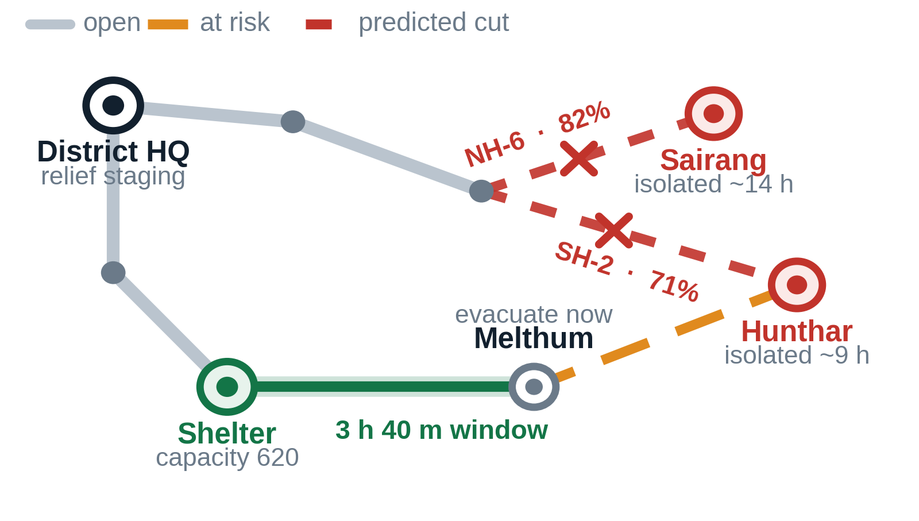




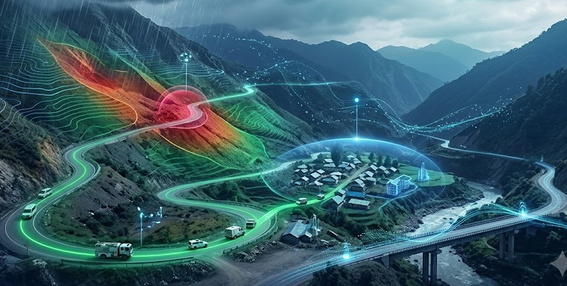


FEASIBILITY AND VIABILITY
ICONIX
LIFE SAFETY
TECHNICAL FEASIBILITY
Proven tech stack (XGBoost, Neo4j, Sarvam)
No custom hardware
Integrates, doesn't rebuild (SACHET).
OPERATIONAL FEASIBILITY
Easy for DDMA/villagers to use
Simple card-based workflow
Clear audit trail stages
Fits existing staff structure
SOCIAL/CULTURAL
NER-specific design
Sarvam Saaras & Bulbul voice
Offline-first for rural areas
Needs community trust
COST STRUCTURE
Data → Free
Infrastructure → Cloud + compute
Development → Manpower only
Integration → Minimal (APIs)
Maintenance → Retrain + upkeep
VALUE PROPOSITION
43.5% of NER landslide-affected
districts represented
Early risk → proactive action
Predict → Prioritise → Act
Business Outcome
↓ Operational disruption
↑ Response efficiency
↑ Infrastructure resilience
KEY BENEFITS
43.5% 64 of 147 affected districts in NER
18.8% India's landslides occurring in NER Himalaya
1,841 NER villages with no mobile coverage
Business Outcome
↓ Operational disruption
↑ Response efficiency
↑ Infrastructure resilience
CHANNELS & DELIVERY
Dashboard - Command & control
Mobile alerts - Field teams
Offline-first - Low-network areas
API integration - Existing systems
POINTS OF SALE
Risk-based deployment
UAV/USV choke-point checks
Lower Conceptual Overhead

Slide 5
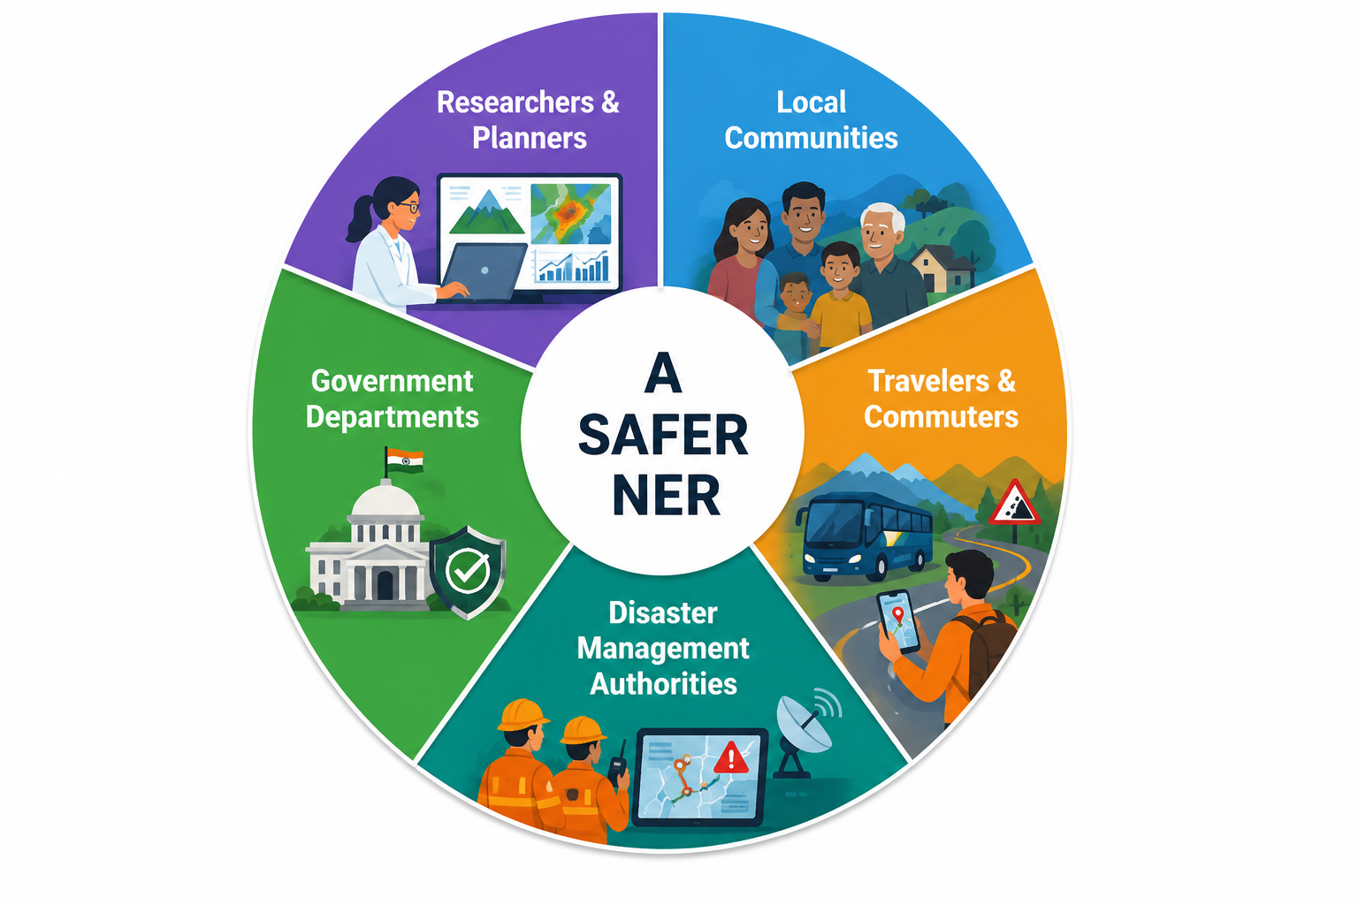
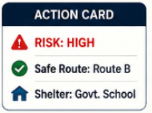
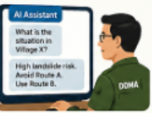

IMPACT AND BENEFITS
ICONIX
LIFE SAFETY
  Early Warning & Risk Reduction
  Offline-first last-mile support
EMERGENCY RESPONSE
  3-Hop Cascade & ICU Priority
  CoE-AWRDS UAV/USV verification
  Zero-hallucination GraphRAG cards
SMART GOVERNANCE
  Human-in-loop validation
  Auditable alerts & actions
  Continuous feedback loop
CONNECTIVITY
  GDS choke-point & road isolation
  Risk-Budgeted A* Safe Routing

Slide 6
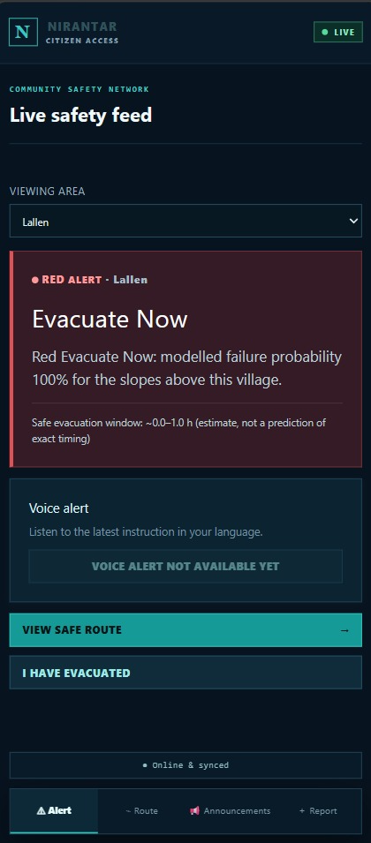
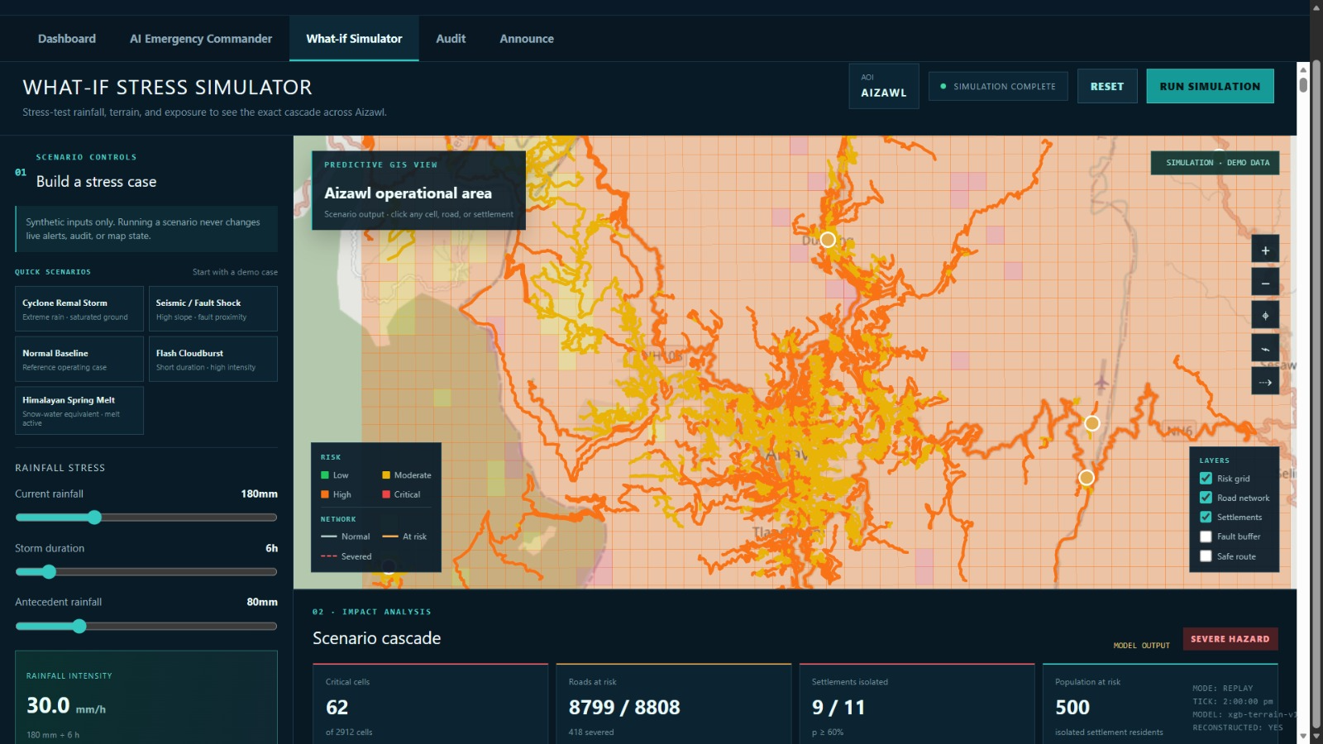
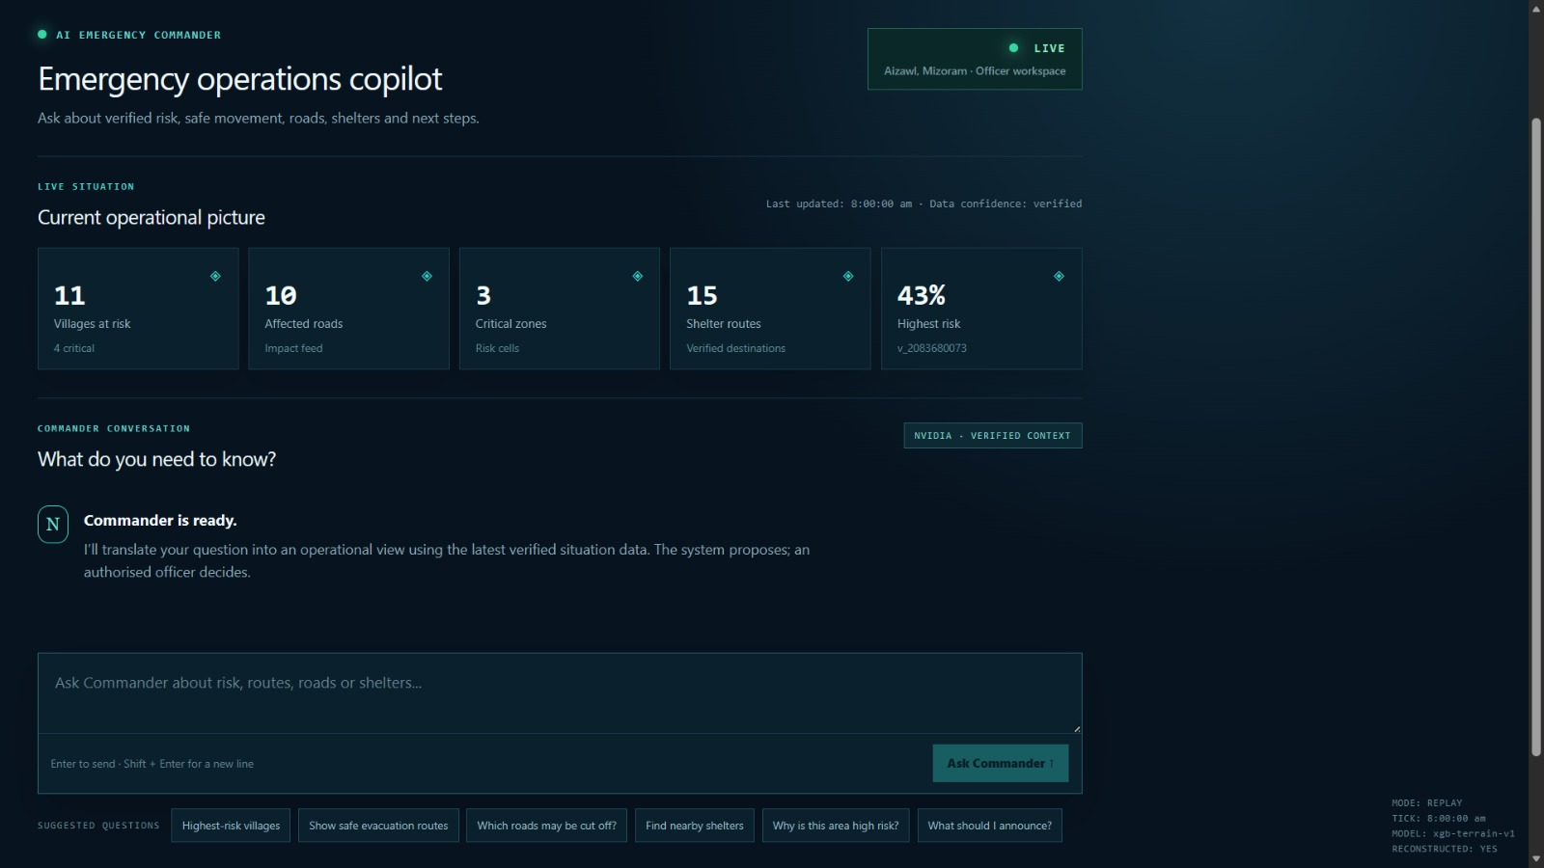
ICONIX
RESEARCH AND REFERENCES
[1]
O. Ghanem, "Predicting Landslide Susceptibility based on Naïve Bayes and Information Value Models in Shibam and AL-Taweelah District, Yemen,"
[2]
. S, M. J, H. G and P. SM, "Evaluating ML Algorithms for Landslide Prediction in Northeast India," 2025 International Conference on Computational Robotics, Testing and Engineering Evaluation (ICCRTEE),
[3]
S. Anand, A. M. A. Sai, A. D. Varma, S. N. Rao, A. Montresor and M. V. Ramesh, "LLM and MCP Enabled AI Agent for Autonomous Multi-Lingual Alerts for Coastal Communities," 2025
[4]
C. Z. John, AI: An AI-Powered Companion for Real-Time Emergency Assistance," 2025 5th International Conference on Evolutionary Computing and Mobile Sustainable Networks (ICECMSN), Coimbatore, India, 2025,
[5]
T . Regula, W. Al-Hoqani, "AI-IoT-Based Federated Edge and Digital Twin Framework for Real-Time Climate-Resilient Hazard Forecasting," 2025
hackFront India 2026
‹#›
hackFront India 2026
6

